Slide 1
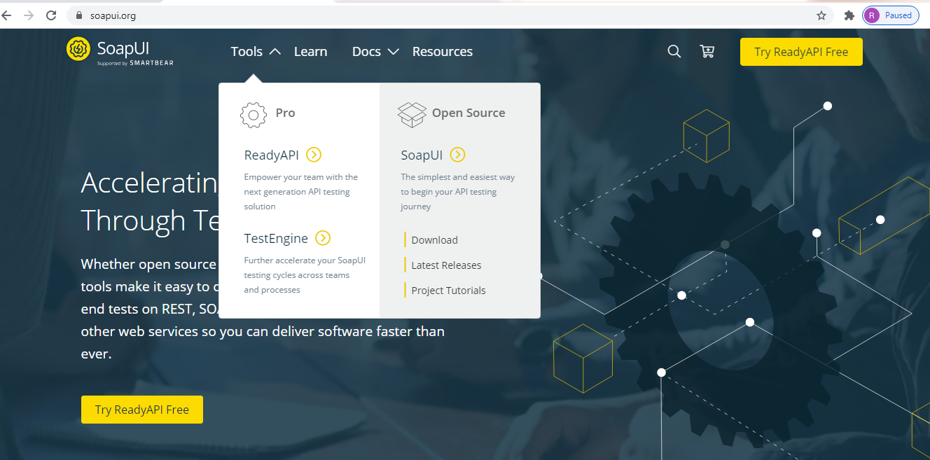
How to install SoapUI?
https://www.soapui.org/

